Slide 1

Evolutionary Pressure on Coronavirus Host Receptors
Shilpa Sanapala
August 5, 2025

Slide 2
Outline
Introduction
Background
Data Collection & Data Preparation
Methodology
Results
Discussion
Conclusion

Slide 3

Introduction
Project Rationale: To understand the impact of coronaviruses on mammalian (particularly bat) evolution
Are bats and other mammals evolving in response to coronaviruses?
Are bats experiencing stronger selection in angiotensin-converting enzyme 2 (ACE2), which is the host
protein bound by SARS-CoV and SARS-CoV-2?
Examined ACE2 genetic diversity computationally, contrasting bats with other mammals using protein sequence data and R/Bioinformatics-based analysis.
Objectives
Select and download ACE2 protein coding sequences and perform multiple sequence alignment (MSA) in R
Estimate per-site evolutionary rates or diversity metrics
Highlight residues under elevated selection in bats
Visualize the differences between bats and non-bats
Importance: Understanding how coronaviruses bind host proteins in the context of diversity, evolution, and potential for cross-species transmission can inform surveillance and public health efforts.
Notes:
Binding to the ACE2 receptor is a critical initial step for SARS-CoVs to enter target cells

Slide 4
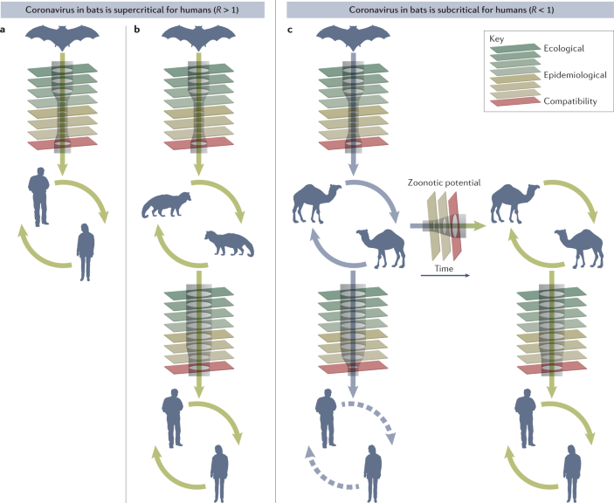
Background
Bats are a major reservoir for coronaviruses with pandemic potential
Three highly pathogenic betacoronaviruses have spilled over into humans: severe acute respiratory syndrome coronavirus (SARS-CoV), SARS-CoV-2, and Middle East respiratory syndrome coronavirus (MERS-CoV)
Genetically diverse SARS-related coronaviruses (SARSr-CoV) have been detected or isolated from horseshoe bats from different regions of China and Europe (78-96% sequence identity)
Specific interactions between high levels of virus sequence divergence and polymorphic host receptors drive coevolution
Ruiz-Aravena et al, 2021
Notes:
Novel viruses with pandemic potential can reach humans by several routes. A virus circulating in bats could have the traits needed for supercritical transmission in humans, by chance or due to evolutionary pressures in the reservoir that fortuitously align with fitness in humans¹⁶¹. Such a virus could spill over directly from bats to humans, overcoming ecological barriers of limited spatial overlap and contacts between these species (see the figure, panel a). Alternatively, such a virus could reach humans via a bridge host that has greater contact with humans than the reservoir host, and perhaps also serves to amplify the virus to high levels to increase the probability of initial infection (see the figure, panel b).

Slide 5
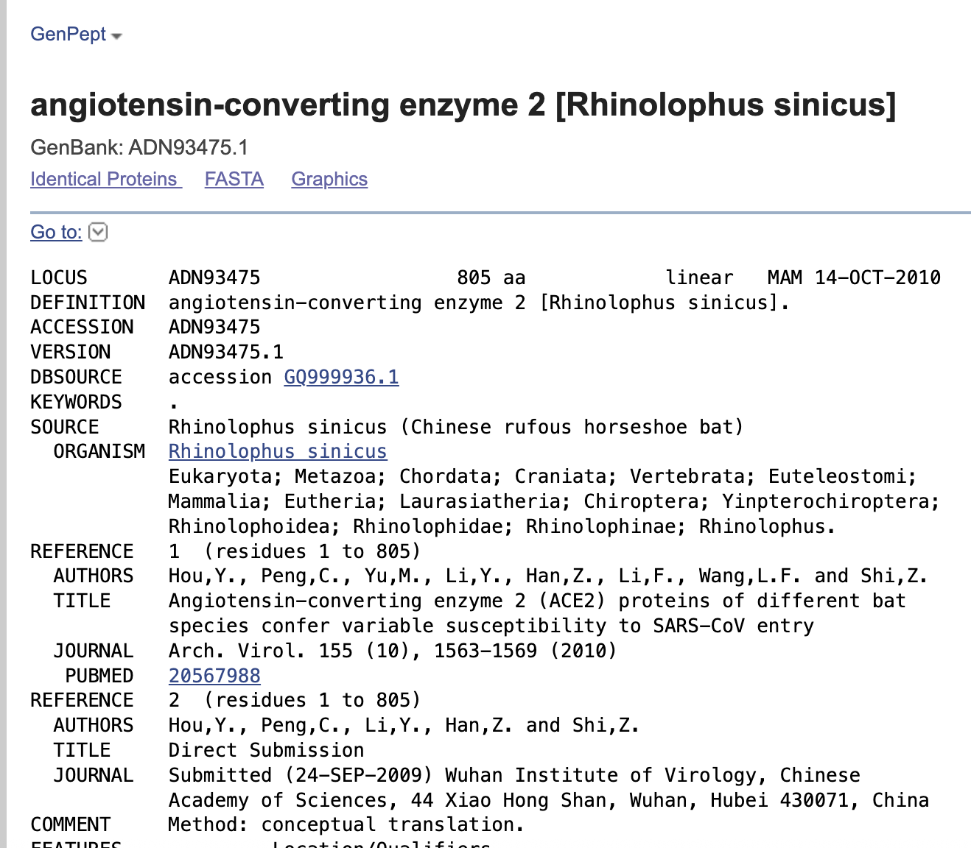

Data Collection & Preparation
Sequence retrieval:
Bat and non-bat ACE2 protein sequences (10 each) were downloaded from the NCBI Protein Database
(https://www.ncbi.nlm.nih.gov/protein) by either using a known accession number from the literature
or by typing specific search queries such as:
“Rhinolophus sinicus”[Organism] AND ACE2 to filter for a specific species and ACE2 protein
The criteria for inclusion when choosing the species were:
Taxonomic diversity (to include species from both major bat suborders: Yinpterochiroptera and
Yangochiroptera)
Ecological diversity (different diets, habitats, behaviors)
ACE2 sequence availability
Known viral reservoirs (species linked to SARS-related viruses)
Sequences were downloaded in FASTA format
All 10 species of bat and non-bats were combined into two single files named “bat_ACE2.fasta” and
“non-bat_ACE2.fasta”, making sure each header includes the species name.

Slide 6
Scientific Name | Common Name | Suborder | Accession Number
Rhinolophus sinicus | Chinese horseshoe bat | Yinpterochiroptera | ADN93475.1
Rhinolophus sinicus | Chinese horseshoe bat | Yinpterochiroptera | ADN93472.1
Rhinolophus ferrumequinum | Greater horseshoe bat | Yinpterochiroptera | ADN93470.1
Pteropus alecto | Black flying fox | Yinpterochiroptera | XP_006911709.1
Pteropus vampyrus | Large flying fox | Yinpterochiroptera | XP_011361275.1
Rousettus aegyptiacus | Egyptian fruit bat | Yinpterochiroptera | XP_015974412.2
Myotis lucifugus | Little brown bat | Yangochiroptera | XP_023609438.1
Myotis davidii | David’s myotis | Yangochiroptera | XP_015426918.1
Eptesicus fuscus | Big brown bat | Yangochiroptera | XP_008153150.2
Desmodus rotundus | Common vampire bat | Yangochiroptera | XP_024425698.2
Data Collection & Preparation
Selected bat species

Slide 7
Scientific Name | Common Name | Notes | Accession Number
Homo sapiens | Human | Reference species | NP_068576.1
Canis lupus familiaris | Dog | Domesticated carnivore | NP_001158732.1
Bos taurus | Cow | Livestock model | NP_001019673.2
Sus scrofa | Pig | Livestock; zoonosis studies | NP_001116542.1
Mus Musculus | Mouse | Model organism | NP_081562.2
Felis catus | Cat | Domesticated carnivore | NP_001034545.1
Macaca mulatta | Rhesus macaque | NHP model | NP_001129168.1
Pan troglodytes | Chimpanzee | Closest relative to humans | A0A2J8KU96
Rattus norvegicus | Rat | Common lab rodent | NP_001012006.1
Mustela putorius furo | Ferret | Model for respiratory virus research | NP_001297119.1
Data Collection & Preparation
Selected non-bat species

Slide 8
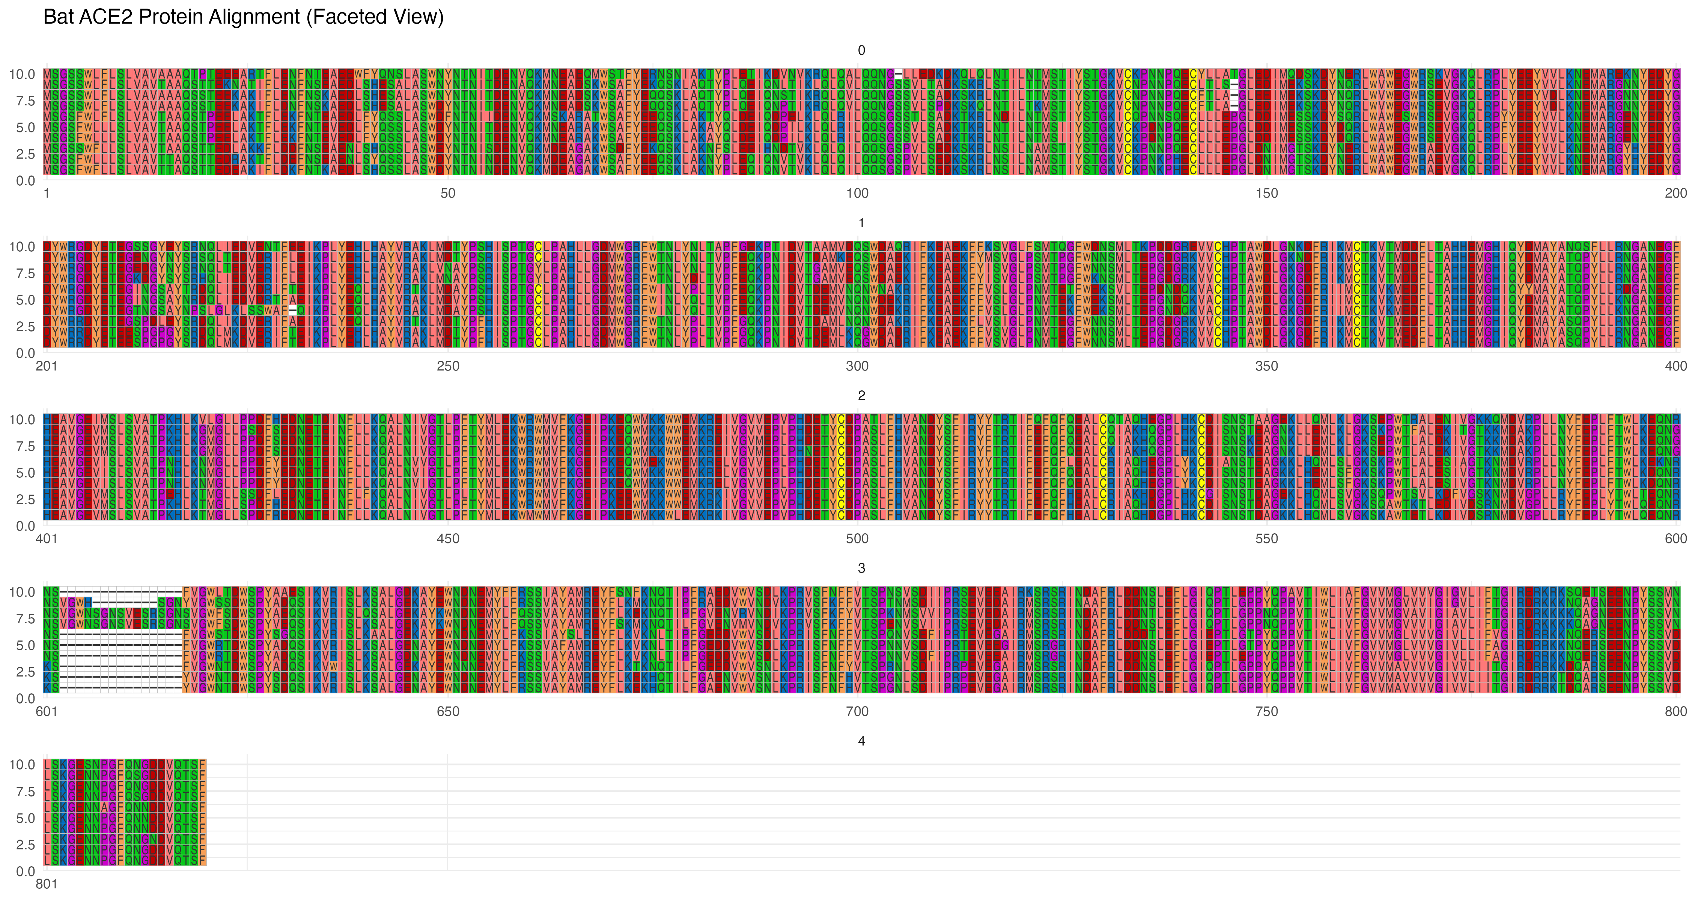
Methodology
Multiple Sequence Alignment: Raw protein sequences were aligned using the MUSCLE algorithm in R
Required packages: Biostrings, msa, seqinr, ggplot2, ggmsa
Output was saved as "bat_ACE2_alignment_for_ggmsa.fasta” and ”non-bat_ACE2_alignment_for_ggmsa.fasta”
Jalview program was used for better visualization by grouping. Annotations were exported for further analysis in Excel to explore conservation patterns, consensus sequence (the most frequent amino acid at each position), phylogenetic tree building, etc
Alignment of bat_ACE2 protein sequences (visualization in R)
Notes:
805 aa but 820 aa with gaps introduced

Slide 9
Methodology
Per-Site Entropy (Sequence variability) was calculated in R for bat and non-bat sequences separately using
Biostrings and seqinr
The alignment was converted to a matrix, and gaps and special characters were removed for accurate
assessment.
The entropy function was applied to each column (site) of the alignment matrix using the principle of
Shannon entropy [H(X)]
H(X) = - Σ p(xᵢ) * log₂(p(xᵢ))
p(xᵢ) is the probability of a specific residue ᵢ occurring at the x position
log₂ is the logarithm to base 2, indicating that the entropy is measured in bits
Low entropy values => highly conserved across the group; high entropy values => greater variability
The divergence metric was calculated using entropy values and the exported annotations from Jalview for
Conservation (bat), Conservation (non-bat), Consensus (bat), Consensus (non-bat)
The top divergent sites were identified

Slide 10
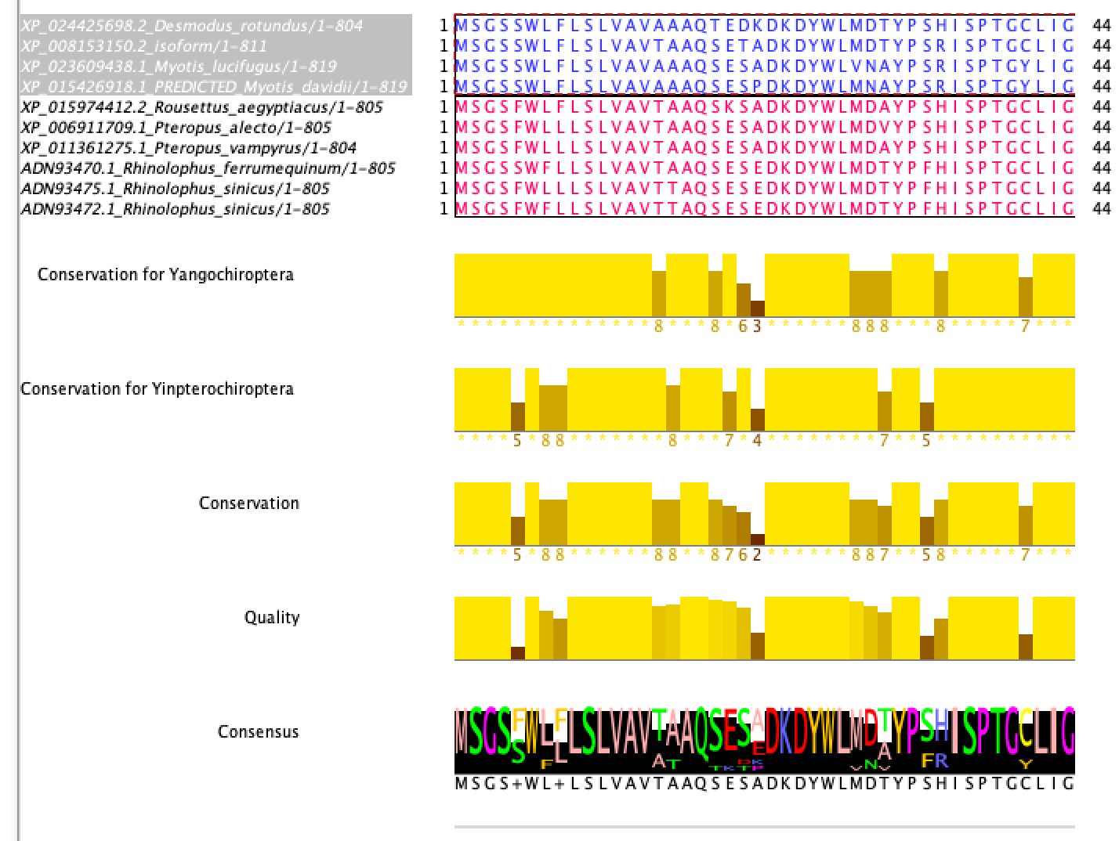
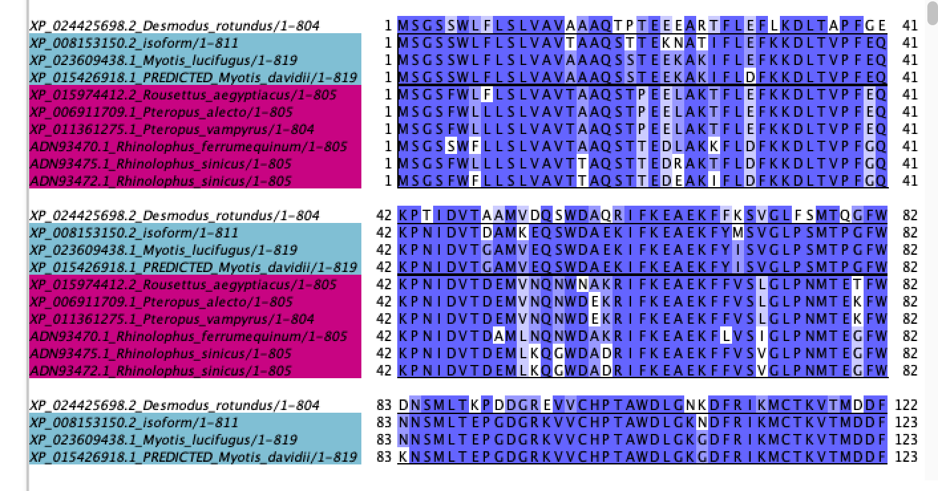
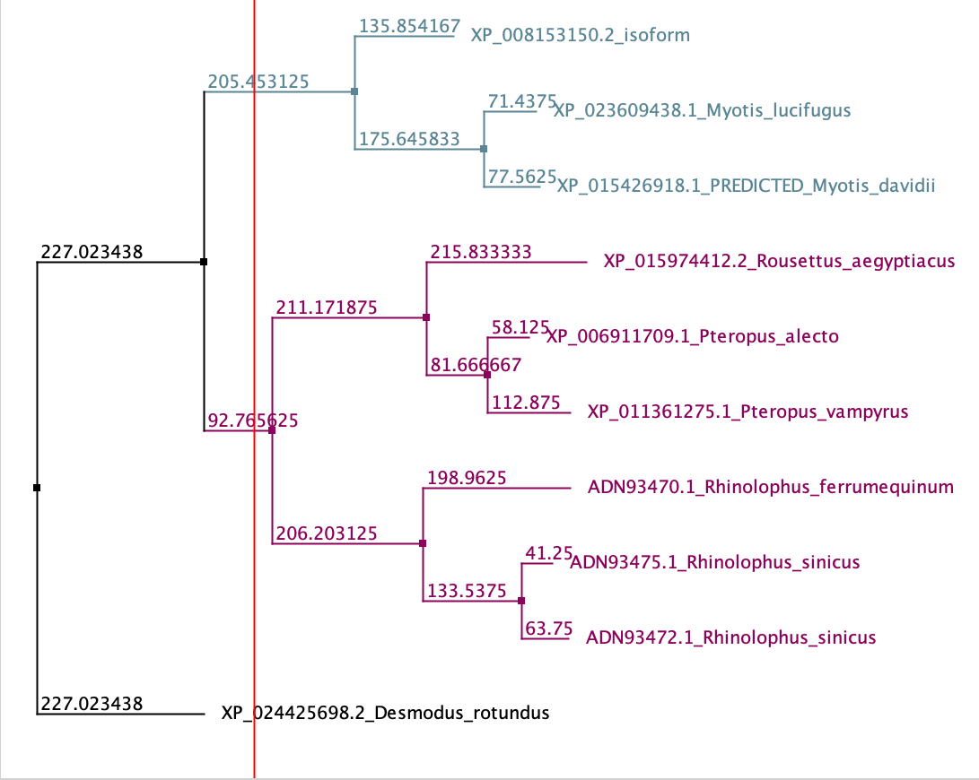
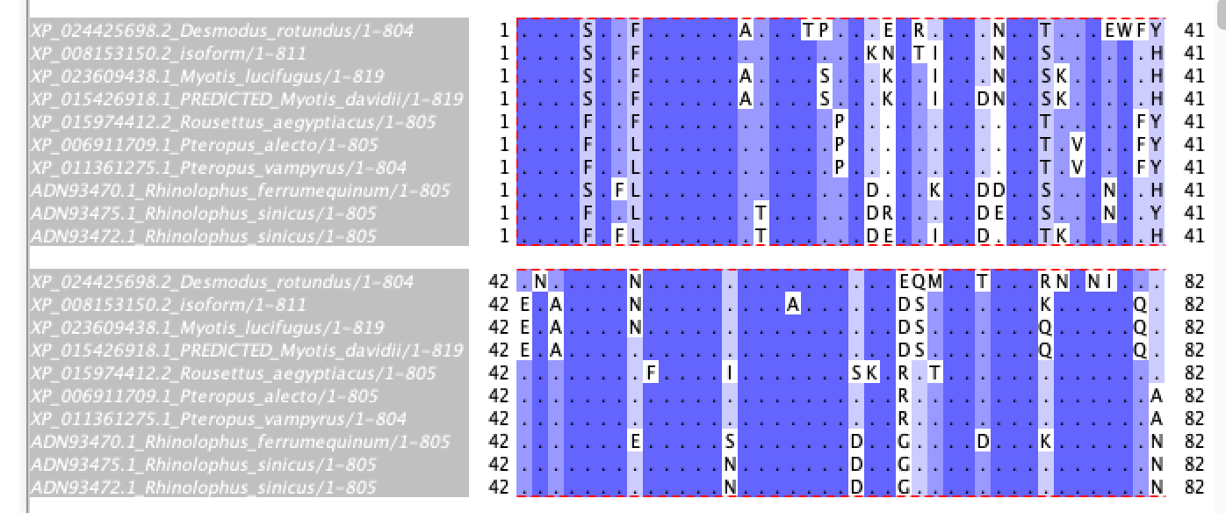
Link to the project: Jalview_Bat_ACE2_ExploratoryAnalysis.jvp
Results
Alignment of bat ACE2 protein sequences (visualization in Jalview) plus phylogenetic tree
Link to the HTML view: file:///Users/shilpasanapala/Desktop/Experimental%20Learning%20in%20Data%20Analytics/Bat_ACE2_htmlview.html

Slide 11
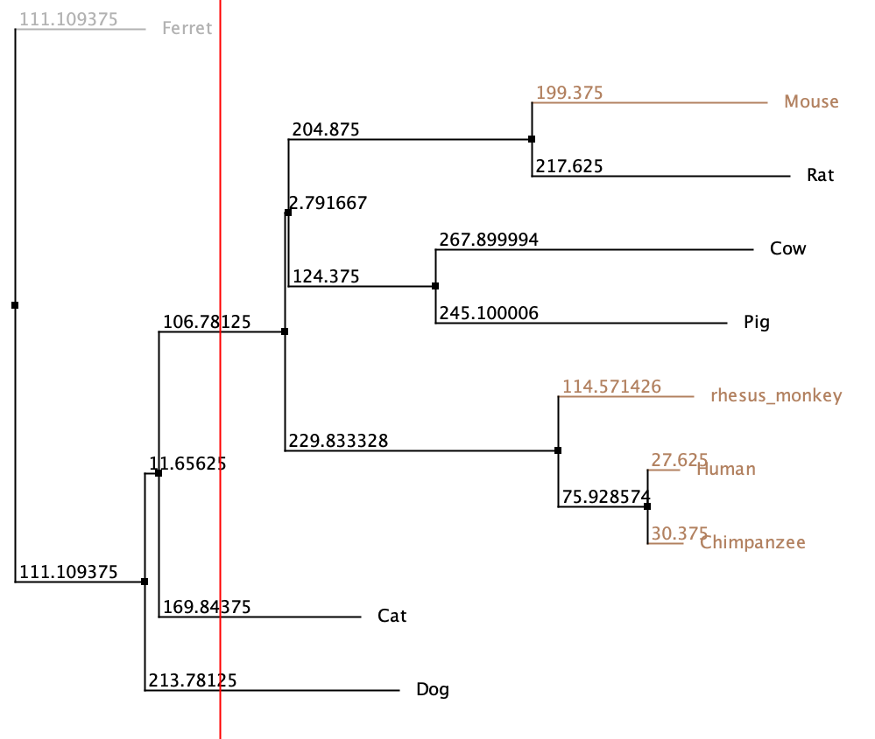
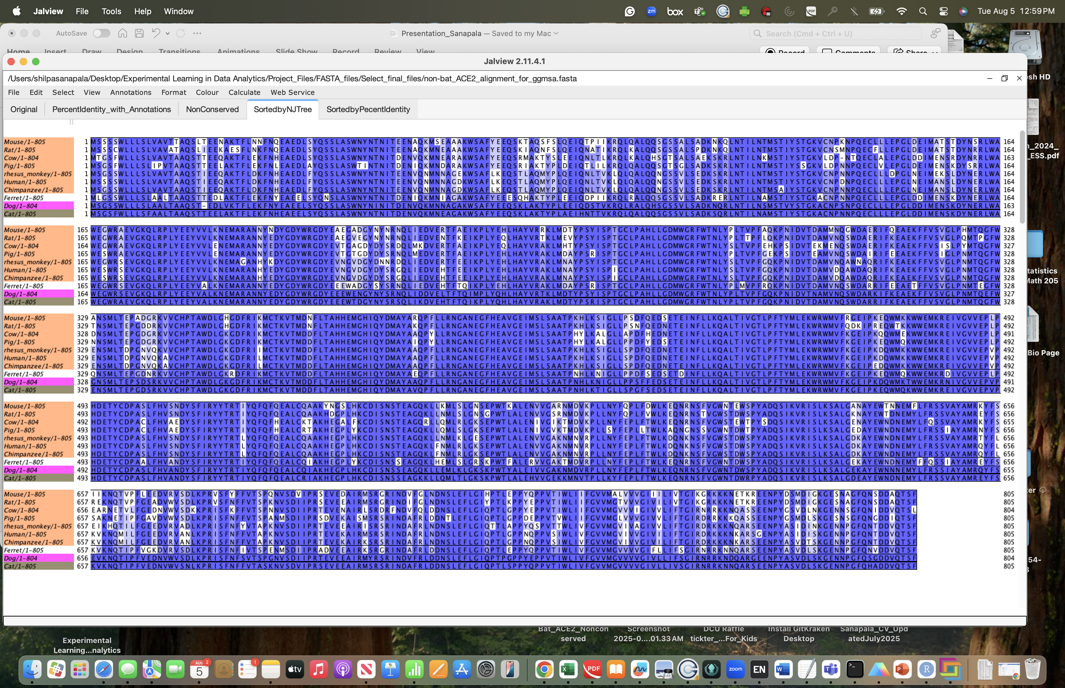
Results
Link to the entire visualization: Jalview_NonBat_ACE2_ExploratoryAnalysis.jvp
Alignment of non-bat ACE2 protein sequences (visualization in Jalview) plus phylogenetic tree

Slide 12
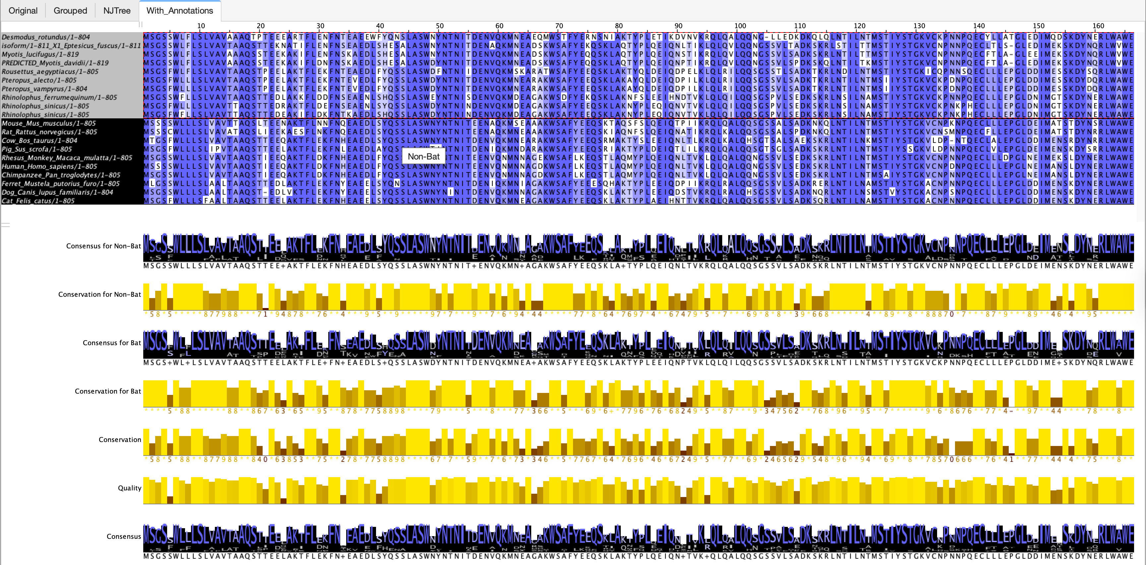
Results
Link to the entire visualization: Jalview_Combined_ExploratoryAnalysis.jvp
Alignment of bat and non-bat ACE2 protein sequences (combined visualization in Jalview)

Slide 13
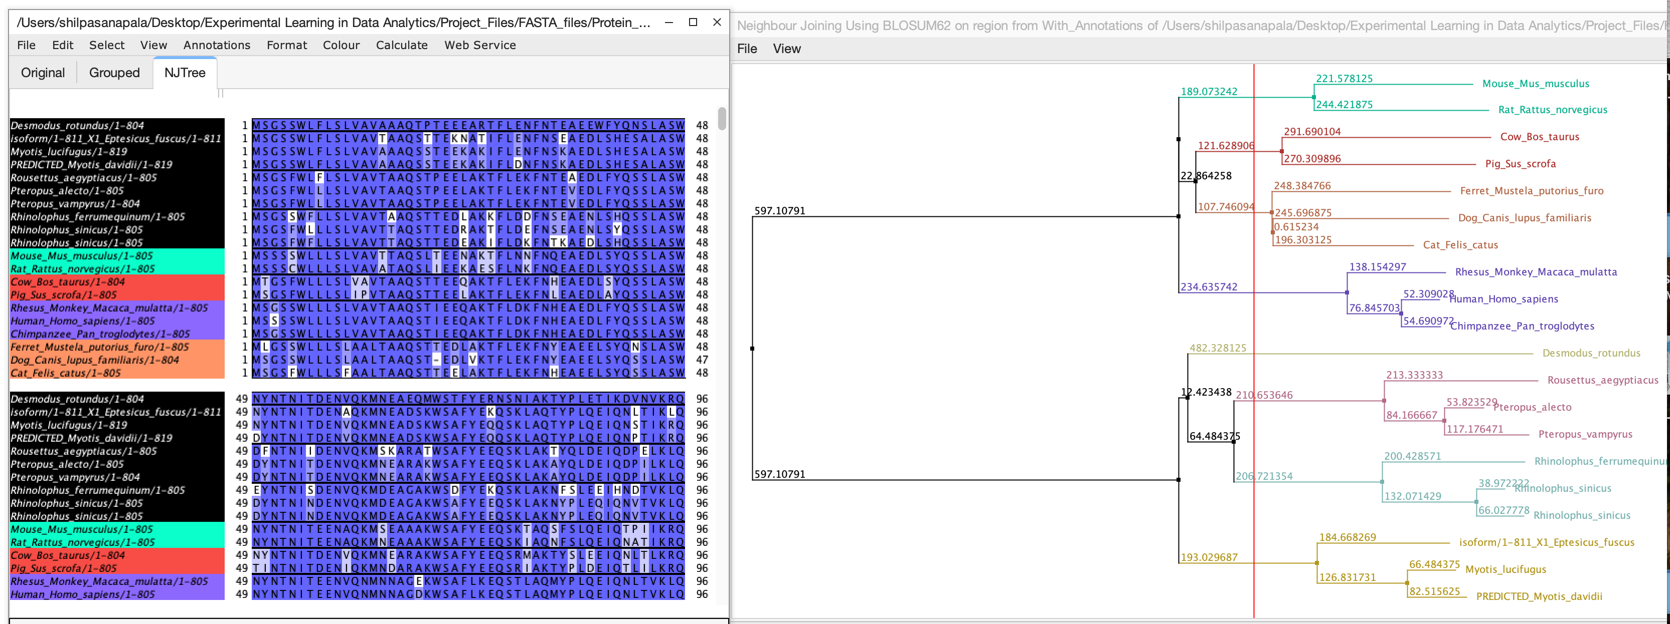
Results
Alignment of bat and non-bat ACE2 protein sequences (combined visualization in Jalview)

Slide 14
Results
Conservation heatmap
Color-coded scores:
Red (0-3) = Highly divergent
Yellow (4-6) = Moderately conserved
Green (7-11) = Highly conserved
The amino acid positions marked in
the red font have experimental evidence
available as the ACE2 interface
residues that coronaviruses bind to.
Residues that contact viruses:
24, 27, 28, 31, 33, 34, 35, 37, 38, 41, 42, 45, 79, 82, 83, 90, 321, 322, 323, 324, 325, 326, 329, 330, 353, 354, 355, 356, 357, 393.

Slide 15
Results

Slide 16
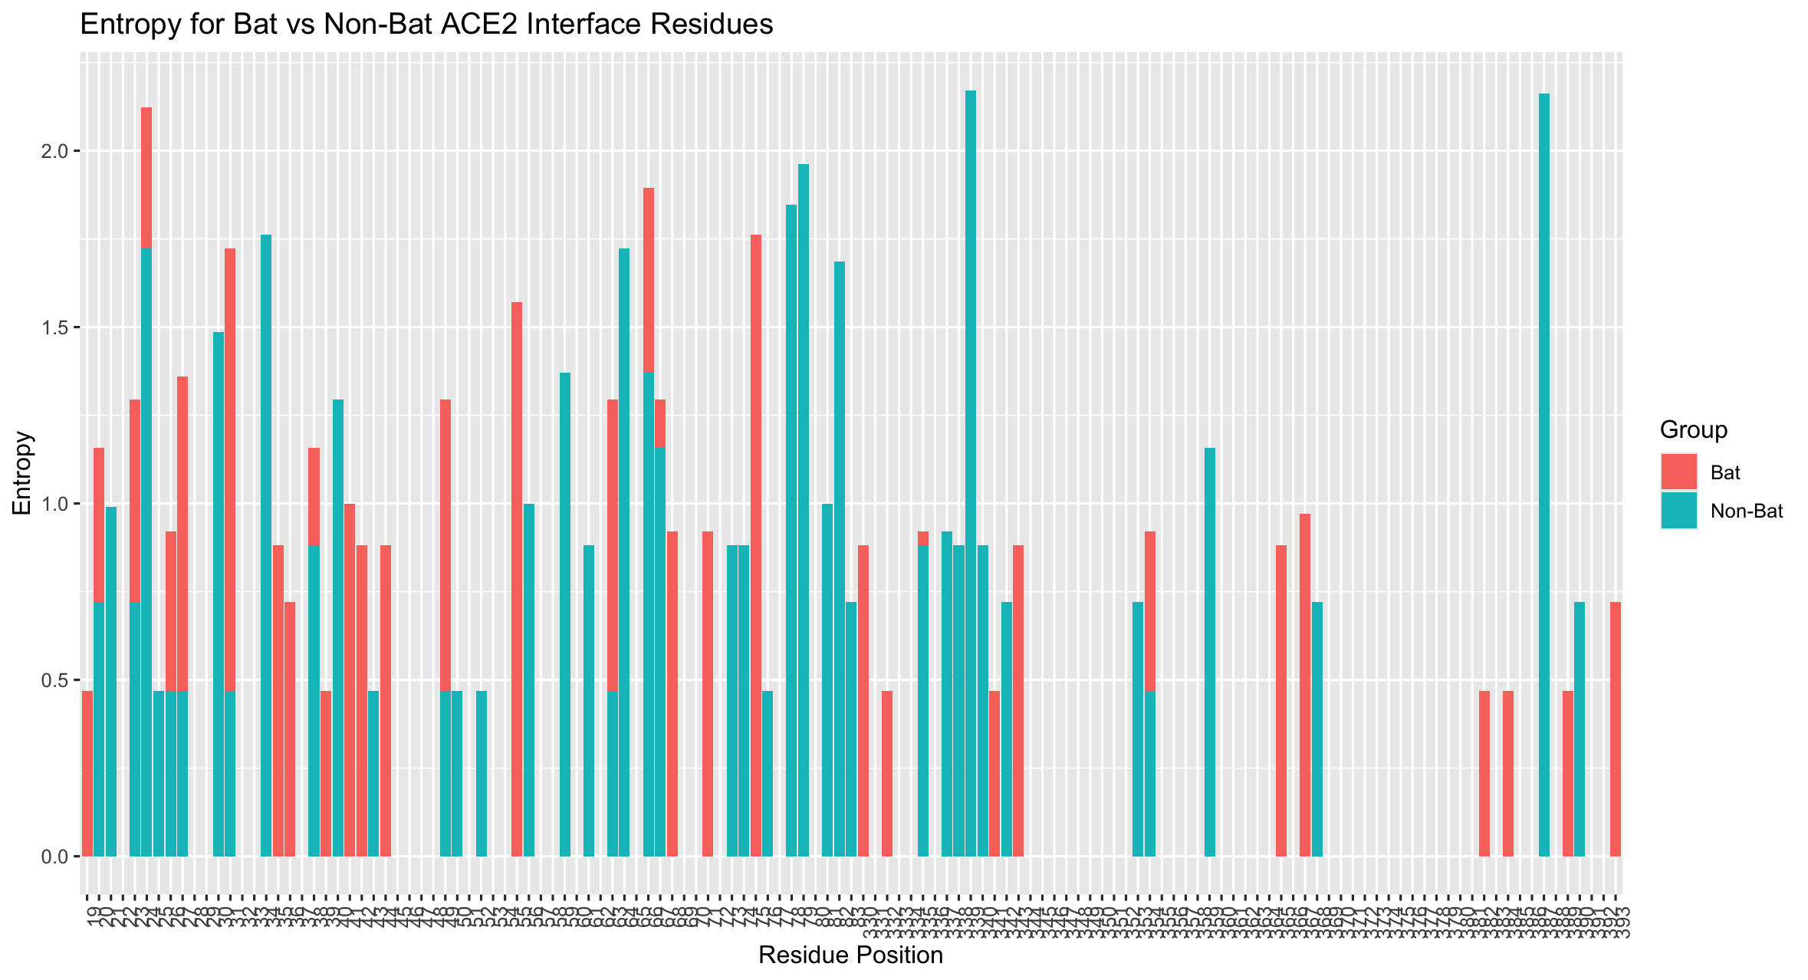
Results

Slide 17
Results
 | Value
Mean_Conservation_Bat | 8.322580645
Mean_Conservation_NonBat | 8.387096774
Mean_Entropy_Bat | 0.743914678
Mean_Entropy_NonBat | 0.612500732
Num_Positions | 31
Num_Consensus_Different | 21
Num_Consensus_Same | 10

Slide 18
Conclusion
Mean conservation score: Both bats and non-bats show high average conservation score
Mean entropy was not significantly different either (p-value was 0.24 when student t test was used)
Out of the 31 positions checked, 21 positions have different consensus residues, while 10 have the same
consensus, confirming that a majority of them are fundamental differences in the dominant amino acids
between bat and non-bat ACE2 sequences.
Are bats and other mammals evolving in response to coronaviruses? Yes
Are bats experiencing stronger selection in angiotensin-converting enzyme 2 (ACE2), which is the host
protein bound by SARS-CoV and SARS-CoV-2? Not sure

Slide 19
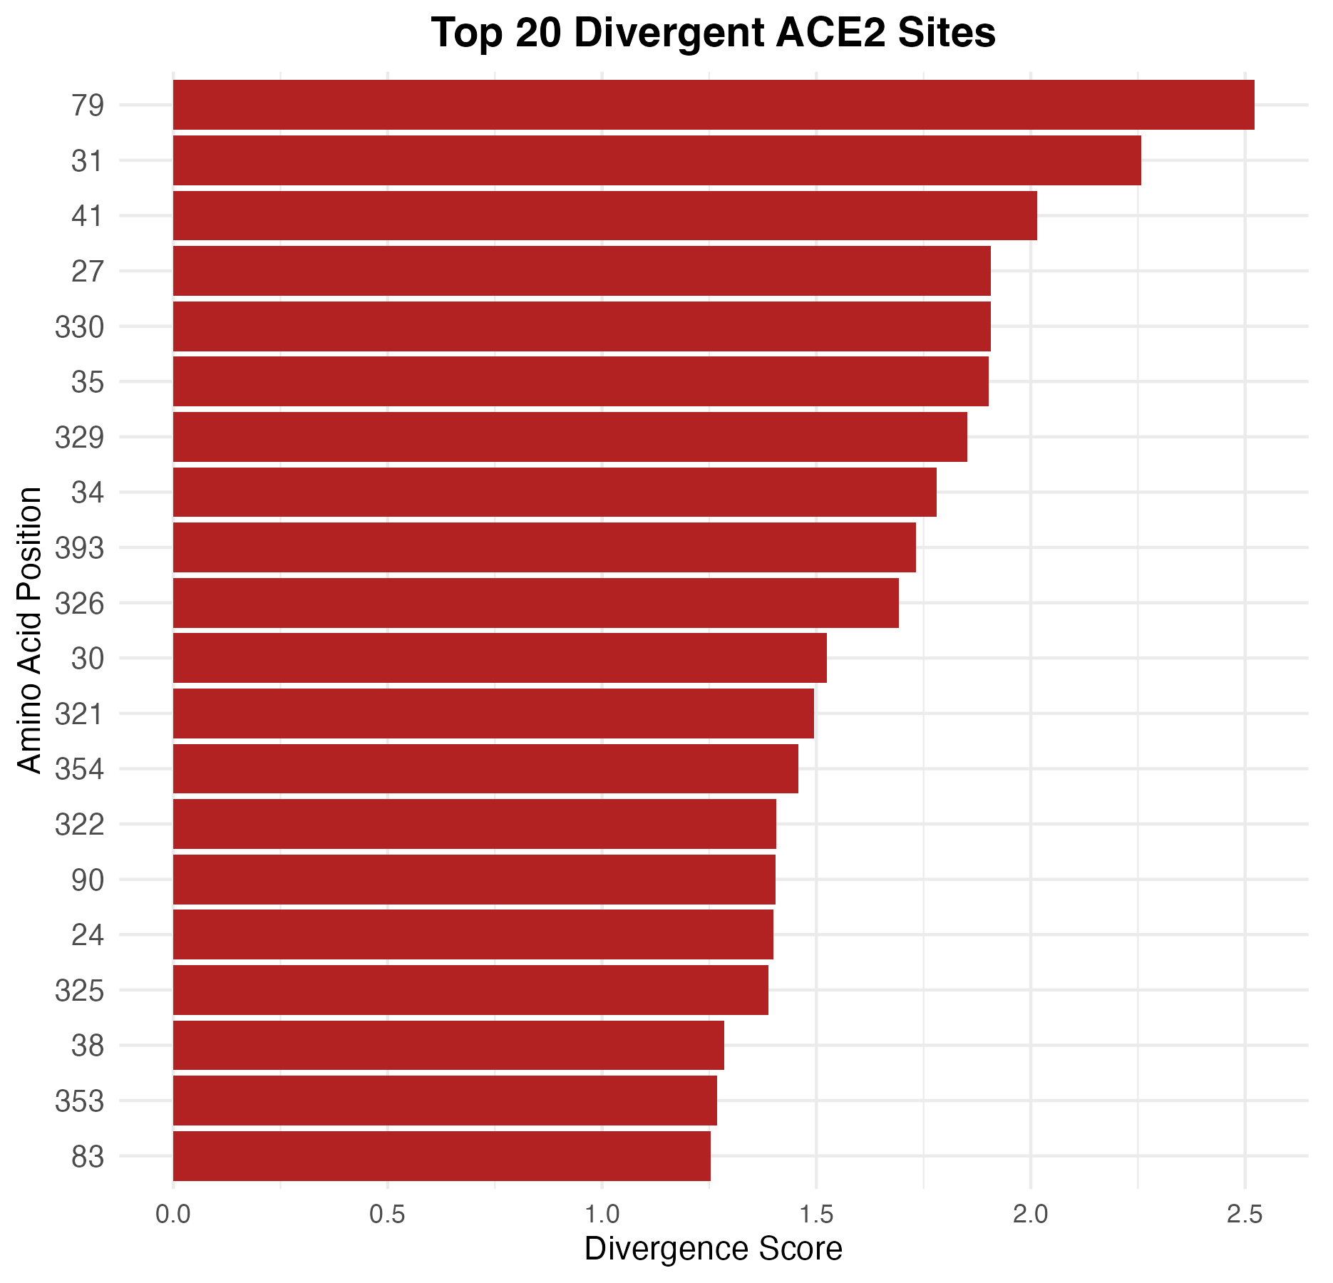
Results
The Divergence score is plotted on the X-axis using a
custom metric that combines:
Consensus difference (binary: 0 if same,
1 if different between bat and non-bat),
Absolute difference in entropy values (bat vs. non-bat),
Scaled difference in conservation scores between
groups (weighted).
Position 79 has the highest divergence,
suggesting a likely functionally or structurally important difference between bat and non-bat ACE2 at this site.
Other highly divergent residues include 31, 41, 27, 330, etc.

Slide 20
Interpretation
Low-Gan et al. (2021) highlight that positions 24, 34, 79, and 82 frequently exhibit more than one amino acid variant across ACE2 orthologs, reflecting evolutionary flexibility
Alexander et al. (2020) also flagged Leu79 as a site with high interspecies divergence correlated with host range susceptibility to SARS‑CoV‑2
Mutation T27W in human ACE2 significantly enhances binding to SARS‑CoV‑2 RBD, demonstrating that residue 27 directly influences viral interaction (Ye et al, 2021)
Position 31 (K31) and Position 41 (Y41): Both belong to the critical ACE2–SARS RBD binding interface. In silico investigations found functional contributions of residues in the 24–38 and 41–42 regions to spike interaction affinity and specificity (Jafary et al, 2021)
Position 330 (N330): Mutation N330Y in human ACE2 has been shown experimentally to enhance spike binding, underlining its functional importance in RBD engagement (Ye et al, 2021)
Conclusion: The finding that Position 79 ranks as the most divergent among bat vs non-bat ACE2 sequences aligns with published observations of its variability and structural evolution. Alongside 27, 31, 41, and 330, these residues are among the known ACE2 sites that influence coronavirus spike binding, host specificity, and infection susceptibility.

